Slide 1
HTML and css
images

Slide 2
images
JPEG(Joint Photographic Expert Group)
GIF(Graphics Interchange Format)
PNG(Portable Network Graphics)
Which format for website?
=> load time vs quality vs scalability

Slide 3
images
GIF
256 colors => small file
animation possible
(full) transparency possible
less suited for photographs (not enough colors)
Often used for logos, drawings and cartoons,
mainly used for animations

Slide 4
images
JPEG
16,7 million colors => larger files
Loss of information (compression)
Not suitable for images with:
few colour differences
lots of text
simple shapes
many lines
Mainly used for pictures with a lot of colors

Slide 5
images
PNG
Combines advantages of both
No animation (in standard PNG)
Transparency possible
Sharp edges are displayed better than with JPEG
PNG-8: 256 colors but better compression than GIF
PNG-24: 16,7 million colors with less compression than JPEG but transparency possible and sharp edges

Slide 6
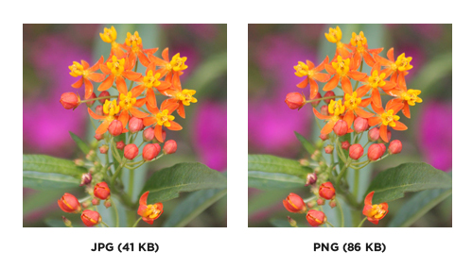
PNG vs JPEG

Slide 7
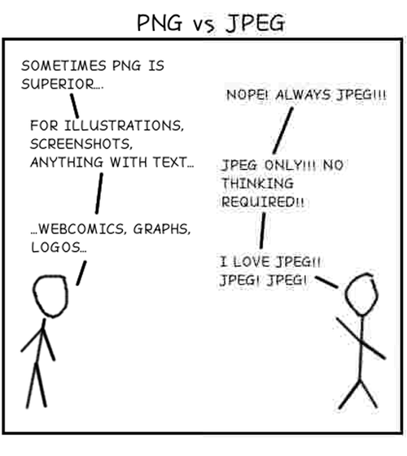
Png vs jpeg

Slide 8

PNG vs JPEG
PNG & JPG

Slide 9
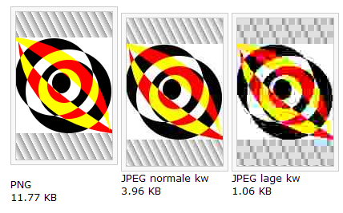
Png vs jpeg

Slide 10
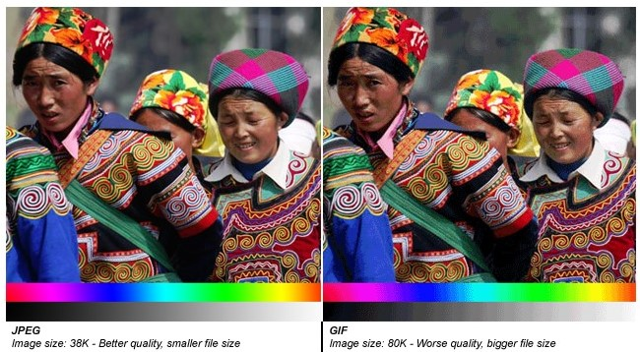
GIF vs jpeg

Slide 11
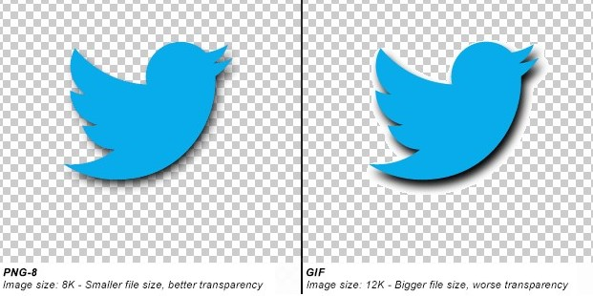
Gif vs png

Slide 12
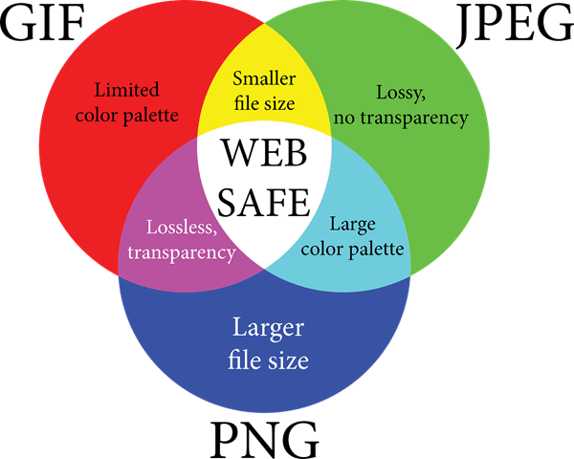
which format?

Slide 13
Which formaat?
Format | Greatest Strength | Greatest Weakness | Used For
GIF | Animation | Complexity | Animated images
JPG | Complexity and file compression | Compression makes simpler graphics look bad | Photos
PNG | Simple, clean graphics; lossless quality; transparency | Complex images like photos can have massive file sizes | Logos; simple graphics

Slide 14
images and attributes
Format:
<img src="photo.jpg" alt="this is a photo..."/>
src: path to image (absolute or relative)
alt:
textual description of image
used by read-aloud software when the image can not be loaded
title:
Appears when user mouses over the image
Can also be used with hyperlinks, lists, …
optional

Slide 15
style
width and height
width and height of the image
pixels or %
text-align: left
right
center
Rounded corners (HTML5)
border-radius:30px;

Slide 16
positioning
wrap text around an image:
<img> before the paragraph that needs to be wrapped around the image
float:left for img in css
image floats left of the text
example

Slide 17
images: links
An image can be used as a link
example

Slide 18
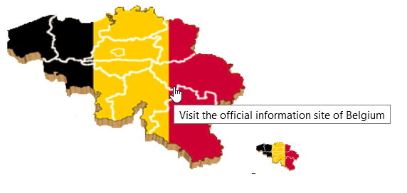
images: exercise
Create a web page that looks as follows:
The big map is a link to the official information site of Belgium:
https://www.belgium.be/
2. If the user mouses over the larger picture, a screen tip is show
The smaller picture is not used as link
The used images can be found on Canvas
<img src="..." alt=“this is a photo..." title="..."/>

Slide 19
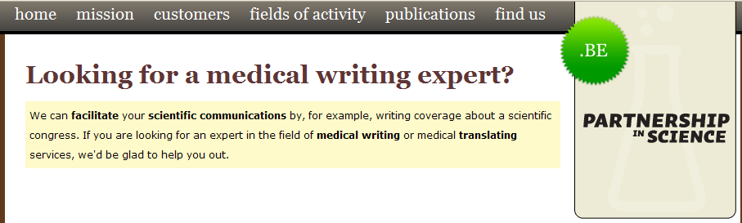
background-image
CSS:
background-image:url("bg.jpg")
Often used?

Slide 20

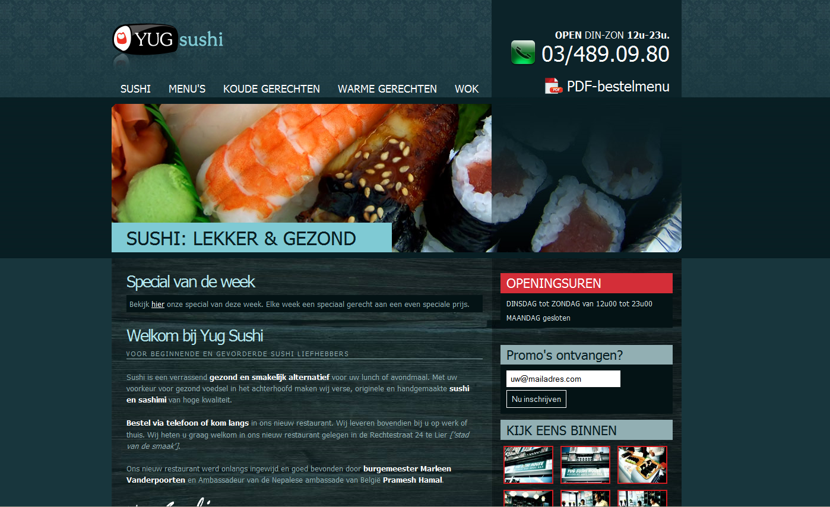
background-image
Background-repeat:
repeat-x (repeat in x-direction)
repeat-y (repeat in y-direction)
no-repeat

Slide 21


background-image

Slide 22
figure en figcaption
<figure>…</figure>
group 1 or more images
<figcaption>…</figcaption>
Add caption to grouped images
example

Slide 23
image-maps
1 image => multiple links
Click on image
Coordinates clicking point generated
send to server: server-sided image-maps
handle in browser: client-sided image-maps
Coordinates determine which link must be activated

Slide 24
Client-sided image-maps
Format:
<map name="mymap">
<area shape="shape" coords="x1,y1, x2,y2, ..." href="file1.htm">
<area shape="shape" coords="x1,y1, x2,y2, ..." href="file2.htm">
...
</map>
Attributes for <map>
name:
Only possible attribute for <map>
Allows to include more than one image-map per webpage

Slide 25
Client-sided image-maps
attributes for <area>
alt="alternative text"
href="URL"
nohref: to exclude a certain area
target="where to show the result of the link"
shape="…": shape of the area
coords="x1,y1, …"
shape | coordinates
circ, circle | x, y, radius
poly, polygon | x1,y1, x2,y2, x3,y3, ... , x1,y1
rect, rectangle | XTopLeft, yTopLeft, xBottomRight, yBottomRight
default | rectangle

Slide 26
Scalable Vector Graphics
Jpg, gif, png:
collection of pixels
Vector graphics:
Collection of lines and shapes, calculated with formulas
advantage: scalable
HTML5:
Can display SVG-images
<canvas>: allows to draw SVG with JavaScript
Tutorial SVG
Tutorial canvas

Slide 27
other media types: audio
Formats myme type
Ogg Vorbis audio/ogg
mp3 audio/mpeg
wav audio/wav
Browser support
Browser | MP3 | Wav | Ogg
Edge | YES | NO | NO
Chrome | YES | YES | YES
Firefox | YES | YES | YES
Safari | YES | YES | NO
Opera | YES | YES | YES

Slide 28
other media types: audio
Attribute | Value | Description
autoplay | autoplay | Specifies that the audio will start playing as soon as it is ready
controls | controls | Specifies that audio controls should be displayed (such as a play/pause button etc).
loop | loop | Specifies that the audio will start over again, every time it is finished
muted | muted | Specifies that the audio output should be muted
preload | auto metadata none | Specifies if and how the author thinks the audio should be loaded when the page loads
src | URL | Specifies the URL of the audio file

Slide 29
other media types: video
Formats myme type
ogg (open standard) video/ogg
mp4 video/mp4
webm video/webm
Browser support
Browser | MP4 | WebM | Ogg
Edge | YES | YES | YES
Chrome | YES | YES | YES
Firefox | YES | YES | YES
Safari | YES | YES | NO
Opera | YES | YES | YES

Slide 30
Andere mediatypen: video
Attribute | Value | Description
autoplay | autoplay | Specifies that the video will start playing as soon as it is ready
controls | controls | Specifies that video controls should be displayed (such as a play/pause button etc).
height | pixels | Sets the height of the video player
loop | loop | Specifies that the video will start over again, every time it is finished
muted | muted | Specifies that the audio output of the video should be muted
poster | URL | Specifies an image to be shown while the video is downloading, or until the user hits the play button
preload | auto metadata none | Specifies if and how the author thinks the video should be loaded when the page loads
src | URL | Specifies the URL of the video file
width | pixels | Sets the width of the video player

Slide 31
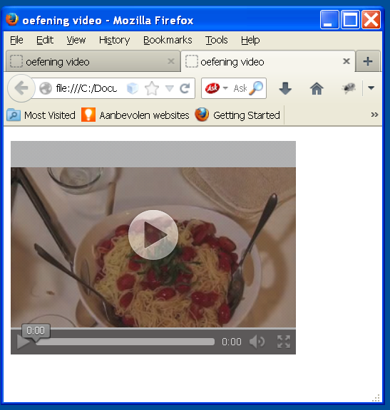
Video: exercise
Create following web page:
The video to be used is capellini.ogg (Canvas)
The image shown before the video
start is "snapshot.jpg" (Canvas)
The size of the video player is
320px x 240px
<video controls poster="…"> <source src="…" type="video/ogg"> Your browser does not support the video tag. </video>

Slide 32
Older media types
tag: <object>…</object>
Silverlight-files (.xap of .xaml) (Microsoft)
java-files (.java of .applet)
QuickTime-films (.mov of .qt) (Apple)
MP3-files (.mp3)
Windows Media files (.wmv of .wma of …)
Mostly plug-in is needed:
<source>
<embed>

